Slide 1

LinkSwift
Building a High-Performance, Global URL Shortener
Name : Amar
Registration ID:12412085
Roll No. : 07

Slide 2



The Core Challenge
The Need for Speed
The Need for Data
Users expect redirects to be **instant**. Any delay (latency) feels broken and loses trust. This is our #1 priority.
Marketers need **deep analytics**: Who clicked? Where? When? This data is complex, slow, and hard to calculate.

Slide 3
Our Quality Targets (The "SLOs")
99.99%
<
50ms
Availability (Reliability)
The service can only be down for 52 minutes *per year*. It must always work, even if parts of it fail.
p95 Latency (Speed)
95% of all clicks must redirect in under 50 milliseconds (faster than a blink of an eye), anywhere in the world.

Slide 4
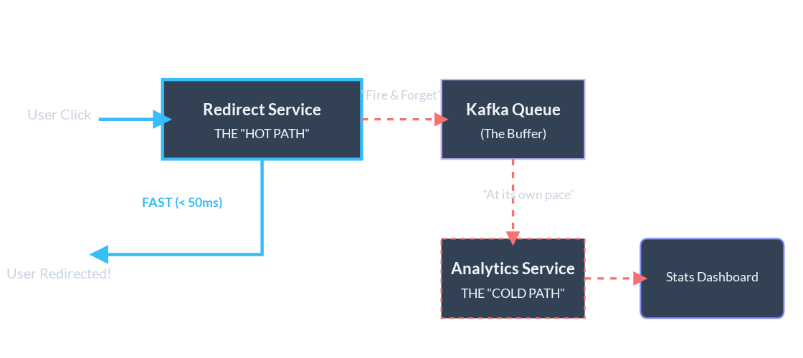
The Solution: A Decoupled Architecture

Slide 5






The "Hot Path": How We Get < 50ms Speed
L1 Cache: CDN
L2 Cache: Redis
L3: The Database
The **"Local Store"** closest to the user. We store popular links here for the fastest possible access (sub-10ms).
The **"Regional Warehouse."** If the local store is out, we check here. It's still very fast and protects our main factory.
The **"Main Factory."** This is the source of truth, but it's slow. We only come here if a link is brand new or very unpopular (<1% of traffic).

Slide 6

The "Reliable Path": Creating a Link
Strong Consistency
When a marketer creates a link, it *must* work instantly, everywhere. We can't have a user click it 10 seconds later and get a "not found" error.
An ID is generated that is guaranteed to be unique.
We use a special **Global Database** (DynamoDB).
This database automatically copies the new link to all regions (USA, Europe, Asia) *before* it tells the marketer "Success!"
This makes the link **instantly available worldwide**.

Slide 7




The "Analytics Path": Smart & Patient Data
Eventual Consistency
The Smart Trade-Off
Analytics is **slow and complex** (GeoIP lookup, cleaning, aggregation). If we did this during the redirect, the user would be stuck waiting, failing our speed goal.
We use **Eventual Consistency**. It’s acceptable if stats are a few minutes late, as long as the user's redirect is fast. This saves our **<50ms SLO**.

Slide 8

The Secret: The "Restaurant Order" (Kafka)
The **Read Service** is the Waiter. Their job is speed: deliver the redirect to the user.
The **Analytics Service** is the Cook. Their job is complex: process the click (payment).
The Digital Order Screen
The **Kafka Queue** is the order screen. The Waiter taps the order in and *immediately* runs away. The Cook handles it when they can. The Waiter never waits for the Cook!

Slide 9





How We Survive Failure (Resiliency)
Active-Active Failover
Circuit Breaker
Rate Limiting
If the analytics (Cook) is overwhelmed, the **Circuit Breaker** flips, and we *stop* sending click events. The redirect (Waiter) keeps working. This protects our 99.99% availability.
We put a speed bump on the road. We only allow a certain number of requests per second from a single IP to protect the whole system from DDoS attacks.
If the *entire* USA region goes offline, Anycast DNS automatically reroutes all traffic to Europe. No one notices.

Slide 10

The Core Trade-Off
We deliberately trade **Analytics Freshness**...
...to guarantee **User Speed**.
“
— The Core Design Principle of LinkSwift —

Slide 11
Thank You
Questions?

